Slide 1

SAP BTP ABAP on Cloud / RAP Training
DAY-9
Anubhav Oberoy
www.AnubhavTrainings.com
Follow excellence with sheer passion

Slide 2


DISCLAIMER
The training content and delivery of this presentation is confidential, and cannot be recorded, or copied and distributed to any third party, without the written consent of Anubhav Trainings

Slide 3

01
CI CD pipeline
02
Cloud Transport and CI
03
Unmanaged Scenario
04
Attachments
Notes:
https://pixabay.com/photos/san-francisco-transamerica-pyramid-1633203/

Slide 4
How did Anubhav build and deploy fiori
Create the Dev space in BAS tool
Open the bas tool and open folder to choose projects folder
We have to open terminal and login to btp a/c cf login -a https://api.cf.us10-001.hana.ondemand.com --sso
Press F1 and choose open application generator to generate Fiori app of template: List Report Template
Select the system as AOC and choose our service binding name for processor
Provide app details, deployment details (btp), launchpad details and create app
Right click on mta.yml and build MTA archieve
Choose F1, open application info and select deploy
Assign the roles of our Launchpad service to our user
Open SAP Build workzone and create a site with name mylaunchpad
Go to channel manager and refresh the apps which are stored in html5-repository
Go to content manager and choose content explorer and pull the app
Create a catalog and a group and add our app to them
Go to everyone role and assign the app to the role
Open the site to test our app
Repeat the same steps if there is a change in the app.
We need to create a git repository and push our app code (backup)
Register a web hook and use the same in CI CD service so that the application will deploy automatically to BTP cloud
www.anubhavtrainings.com

Slide 5
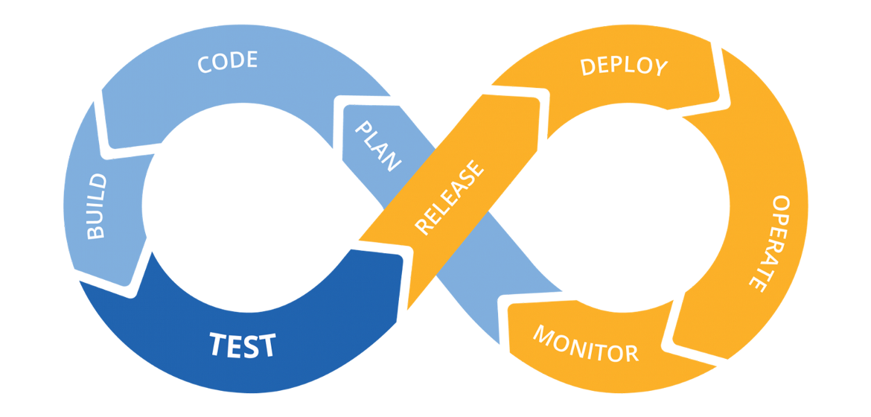
Hands on: Continuous Integration

Slide 6










































Slide 7
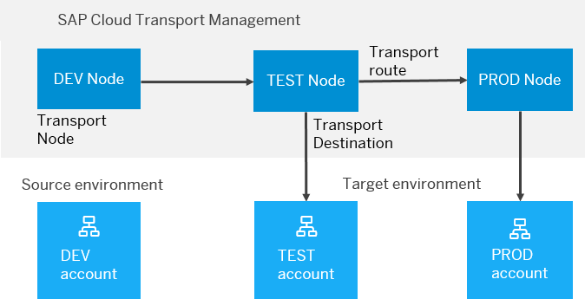
BTP Cloud Transport Management
SAP Cloud Transport Management service lets you manage software deliverables between accounts of different environments (such as Neo and Cloud Foundry), by transporting them across various runtimes. This includes application artifacts as well as their respective application-specific content.
SAP Cloud Transport Management service adds transparency to the audit trail of changes so that you get information about who performed which changes in your production environment, and when they did it. At the same time, the service enables a separation of concerns: For example, a developer of an application or of SAP Cloud content artifacts can trigger the transport of changes in a development subaccount, while the resulting import into the test, and production subaccount is handled by a central operations team.

Slide 8

Hands on SAP BTP Cloud Transport

Slide 9
Reference Scenario – Unmanaged Impl.
Imagine in our company we had written all the business logic in the past ourself in form of FM, Classes. Today we want to reuse our old code which has the business logic, validation, sequence, processing, along with transaction buffer. So if you want to manage all these codes yourself and integrate your legacy (old code written by you or your team), you will opt for unmanaged (here RAP is not managing the CURD operation) scenario.
SAP is providing a demo class for learning purpose viz. /dmo/cl_flight_legacy
In this class we have our own old logic which contains the transaction buffer and business logic to maintain all the source code to interact with database ourself.
The RAP framework allows us to implement the entire runtime of the BO
Interaction Phase (code to interact and keep data inside itab)
Transaction Buffer (like a internal table where we keep temporary data)
Save Sequence (Commit work and Rollback)
UPDATE_BAPI
(LUW)
BAPI_TR_COMMIT
BAPI_TR_ROLLBACK
www.anubhavtrainings.com

Slide 10
Development Flow
Serv Impl.
BIMP-unmanaged
Serv definition
BDEF - unmanaged
Travel_U
Travel_U_MDE
Agency
Customer
agency
customer
/dmo/travel
www.anubhavtrainings.com

Slide 11
Title
<>
How you know in the code which fields are changed on the screen by the user.
So accordingly we can update the data into the database only for the changed fields??
RAP provides a compiler structure called %control which will tell us what fields were changed on UI.
We need to tell the RAP, what will be the datatype for the control structure.
*
*
*
www.anubhavtrainings.com

Slide 12
Attachments
Starring SAP ABAP on Cloud release 2208 SAP started direct support for attachments (PDF, Excel, Images, TXT, Word) including binary files. We must need to create a database table with atleast following columns
Attachment (Data type: RAWSTRING length 0)
Mimetype (Document type, String128)
Filename (Document Name, String128)
Travel
Attachments
1 n
www.anubhavtrainings.com

Slide 13
Steps
Create new attachment table according to need and design
Create a Interface Entity for the attachment table and mark our attachment field with special attachment annotation, So the RAP framework can treat it as an attachment accordingly.
Add annotations for admin fields, and user labels.
Create composition of our attachment table with travel entity like we had the composition of booking with travel entity.
Create a projection view for attachment
Relationship between Travel processor view with attachment processor view entity
Enhance the BDEF with attachment like booking
Also expose the attachment functionality with draft to processor in behavior projection for processor
Expose the entity of attachment processor in service definition
Republish the OData V4 binding
Add the metadata extension for attachment scenario and link a new facet in travel for attachment table
Testing
www.anubhavtrainings.com

Slide 14
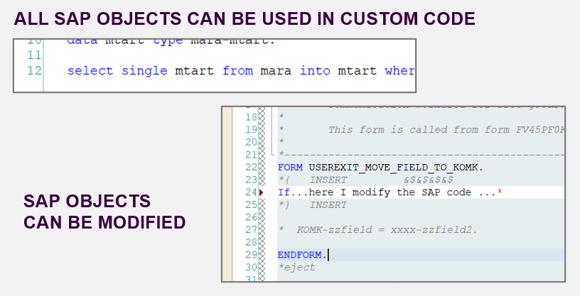
From classic ABAP extensions to ABAP Cloud development
<>
www.anubhavtrainings.com

Slide 15
What is ABAP Cloud Development Means:
Use public SAP APIs (local or remote) released by SAP to access SAP functionality and SAP data
Use public SAP extension points released by SAP to extend SAP objects. Modifications to SAP standard objects are not supported (applies to S/4HANA Cloud system)
Use of Adt (ABAP development tools) on eclipse
Use Steampunk (RAP – Restful Application Programming model) to build Fiori Applications and services. SAP technologies like Dynpro and webdynpro are not released for cloud development.
www.anubhavtrainings.com

Slide 16
What is Embedded Steampunk
If we are using SAP BTP to develop side by side extensions, full stack SAP applications in BTP (Steampunk)
If we are using In-app Developer extensibility with released objects in S/4HANA (all editions) with RAP (Embedded Steampunk)
If you using RAP and enhancing your Standard SAP Applications delivered by SAP in S/4HANA system, the recommended approach is Embedded Steampunk.
Every Customer using S/4HANA can decide whether they want to use new approach (embedded Steampunk) or classic extension approach (BADI) @ Object level
This can be done by switching a setting @ object level.
www.anubhavtrainings.com

Slide 17
www.anubhavtrainings.com
Thank You
End of Day 8
www.anubhavtrainings.com

Slide 18


We’re committed to empower you to be
#FutureReady
through powerful training solutions.
We build the workforce of the future.
250+
Corporate Clients
30,000+
Learners Trained
25000+
Learners Placed
FREE WEBINARS
Sign up for free webinars with industry experts every fortnight!
Enroll Now!
Contact us today!
https://anubhavtrainings.com

